Slide 1
CNN review (from ResNet to EfficientNet)
Jaehong Ju

Slide 2
ResNet
DenseNet
SENet
MobileNet
EfficientNet

Slide 3
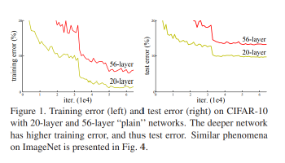
Deeper but not Better, why?

Slide 4
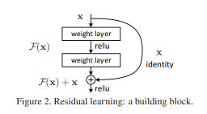
ResNet: Residual Learning
Shortcut connection
(Skip connection)

Slide 5
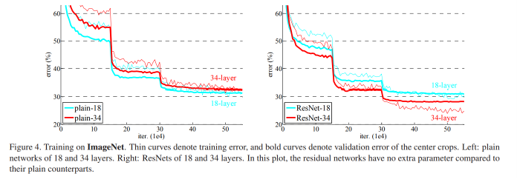
Better performance, how?

Slide 6
Better performance, how?
Resolve “Vanishing gradient”?
→ Nope! BN should be enough

Slide 7
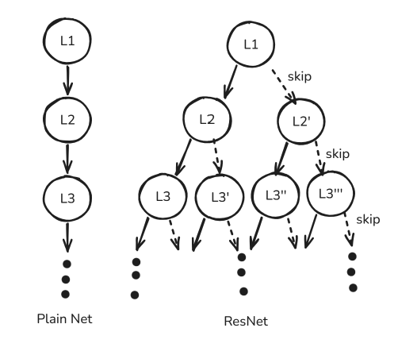
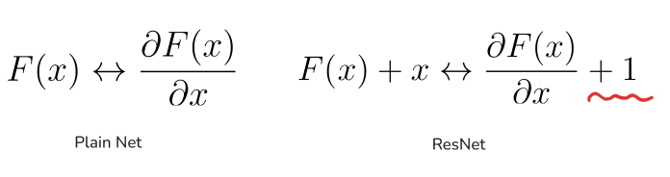
Better performance, how?
Ensemble
Back Propagation
Dynamical Isometry: keep Jacobian values 1
(Resurrecting the sigmoid in deep learning through dynamical isometry: theory and practice, 2017)

Slide 8
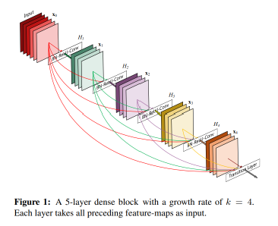
DenseNet
Densely Connected
Each layer takes all front results
concat instead of add

Slide 9
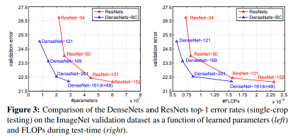
DenseNet
Better Performance, but how about memory?

Slide 10
SENet
Some channels are more important than others

Slide 11
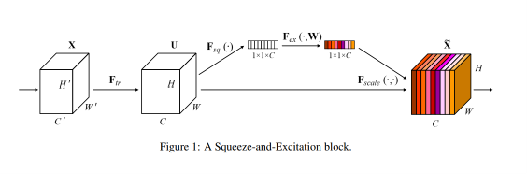
SENet
Squeeze & Excitation

Slide 12
SENet
Squeeze: Global Information Embedding
(kind of average)

Slide 13
SENet
Excitation: Adaptive Recalibration

Slide 14
MobileNet
How about Optimizing CNN?

Slide 15
MobileNet
Depthwise-Pointwise Convolution
Inverted bottleneck

Slide 16
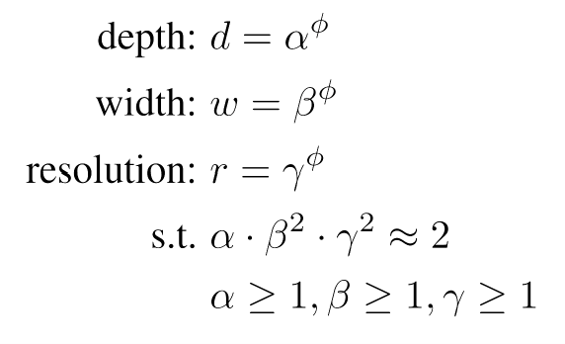
EfficientNet
Golden ratio of scale?

Slide 17
EfficientNet: architecture
MBConv(Inverted bottleneck of MobileNet)
S & E Optimization of SENet
Compound scale method

